Slide 1
Aortopathy in Patients with Bicuspid aortic valve

Slide 2
Notes:
Aimed to address one of the question that has puzzled many is why some patients develop this complication and other do not,.,

Slide 3
Bicuspid Aortic valve
Most common Congenital heart disease
Diagnosed incidentally in TTE
Prevalence – 0.7% - 1.4%
Predominance in Men - 2:1 – 3:1

Slide 4
Notes:
70-90% of BAV have raphe between the cusp.

Slide 5
Important clinical implications are:
Valve dysfunction,
Aortic dilation,
Infective endocarditis,
Aortic dissection
Notes:
AD is the most feared complication; although its incidence in absolute numbers is low, the age adjusted relative risk is 8.4 times higher in BAV compared with general population.

Slide 6
Risk factors for Aortic dissection in BAV:
Uncontrolled Hypertension
History of Coarctation
F/H of Aortic dissection / Early Unexplained SCD
Aortic diameter increase of > 3mm / year
Prophylactic Asc. Aorta replacement at lower threshold
(Aortic diameter > 50mm compared to 55mm)

Slide 7
BAV with AS
R-N > R-L
Severity -> Calcific leaflets
Notes:
As is the leading cause of valvular dysfunction. 14-50%
Increases with age,
Associated with cardiovascular risk factor
More frequenly in RN compared to RL.
AS severity is associated with calcification of aortic valve
This is Rare L-R fusion.

Slide 8
BAV With AR
Higher in male patients
Prevalence - 23-70%
Increases with aortic root diameter
Approximately a quarter of AR → Aortic root dilation

Slide 9
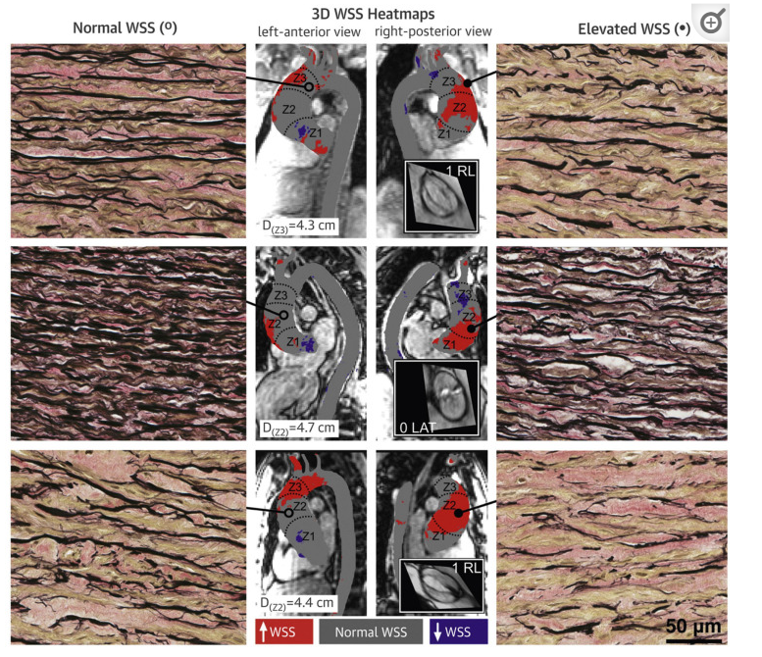
Bicuspid aortopathy
Dilation of Thoracic aorta →
1) Disruption of elastin and collagen fibers
2) Smooth muscle cell loss
3) Metallo-proteinase release
4) Loss of fibrillin 1 microfibril
Notes:
Consequence of complex pathological process

Slide 10
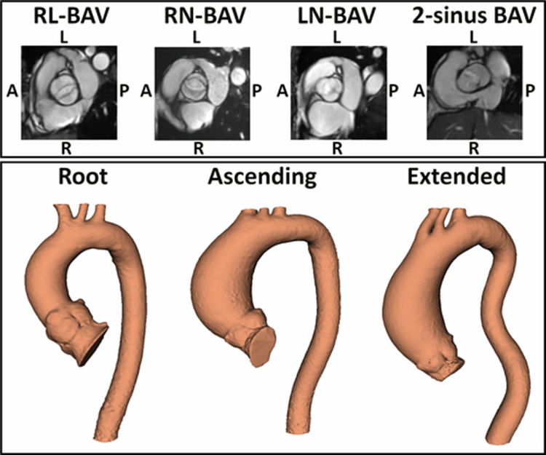
20-30%
60-80%
Notes:
Aortic dilation may affect from root to the proximal mid arch. Present in paediatric population even without valve dysfunction.

Slide 11
Aortic aneursym
RR 80 times higher in Bav Than in general population.
More Rapid in BAV than in TAV
0.2 – 2mm / year increase in BAV
Root dilation → Malignant course

Slide 13
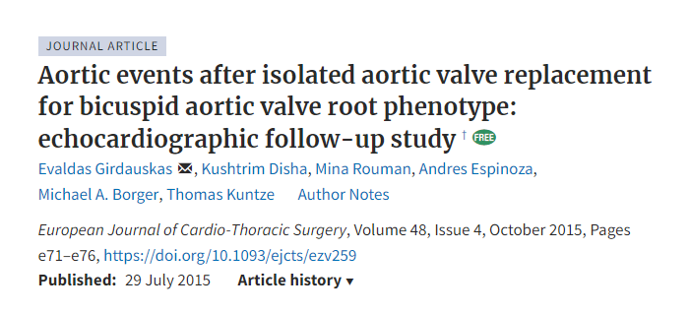
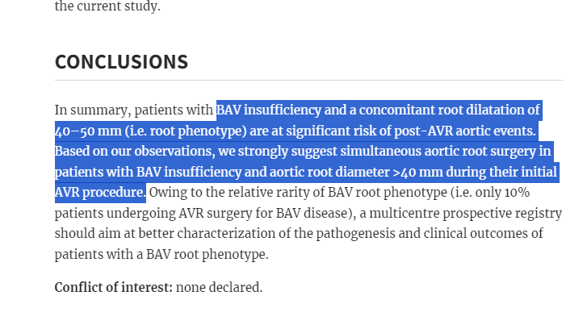
Notes:
Some studies have even put for the hypothesis that due to the malignant nature of the disease, even root dilation more than 40 mm might require surgery . But large randomized control study is needed.

Slide 14
Ascending Aorta phenotype
MC phenotype of any valve morphology
Common in anterior aortic wall → extend to aortic arch
RN BAV
Older age at diagnosis
Associated with AS

Slide 15
Root phenotype
Genetic cause
More malignant form / Faster growth rates / higher AEs.
RL BAV / Rarely in RN BAV
Earlier age at diagnosis
Associated with male sex and AR
AS is inversely related
Notes:
The 2 main phenotypes have different genetic basis and different flow pattern

Slide 16
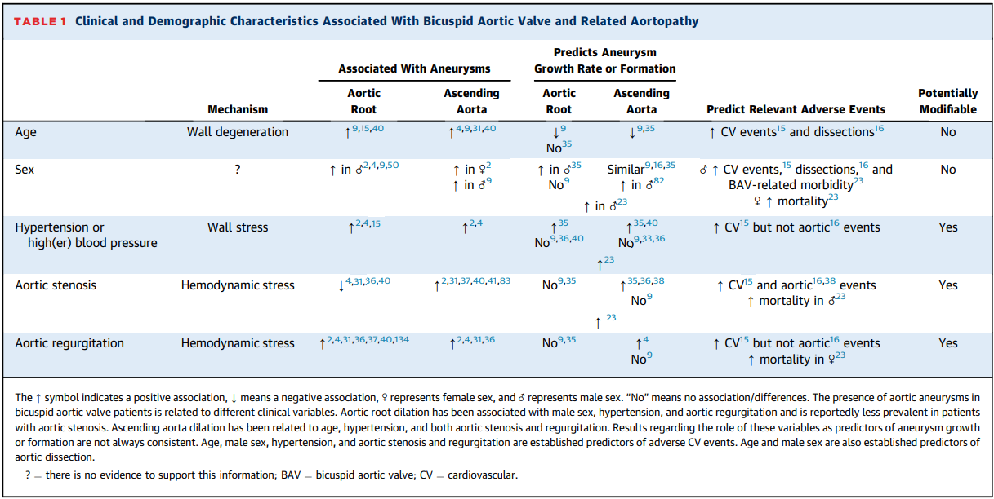
Notes:
Age and male sex are predictors of aortic dissection
Root→ male hypertension AR
Ascending aorta → age hypertension both AS and AR

Slide 17
Pediatric population
Prenatal dilated ascending aorta is a rare finding (0.06%) → 37% of them had BAV
Dilation (in child ) → Normally functioning valve
Aortic diameter progression was reported as very slow
( Predictors – severity of valvular disease / uncorrected coarctation;
No impact on BAV morphotypes )
History of coarctation → Smaller roots and ascending aorta diameter
Related aortic events like Aortic dissection are extremely rare in children and adoloscents
Notes:
Genetic hypothesis
BAV is the most common association with aortic dilation in the fetal period.

Slide 18
Non invasive imaging
1)ECHO
2)CT
3)CMR
Aortic dilation detection:
TTE → First line ( Less precise particularly beyond aortic root)
Measurement of Diameters from Annulus to the descending thoracic aorta ( assess coarctation also)
Notes:
To assess aorta size and possible predictors for growth formation
Periodic life long assessment

Slide 19
Aortic root asymmetry
The long axis of the ovoid root (i.e. largest aortic root diameter) is roughly perpendicular to the aortic valve opening in all BAV patients.

Slide 20
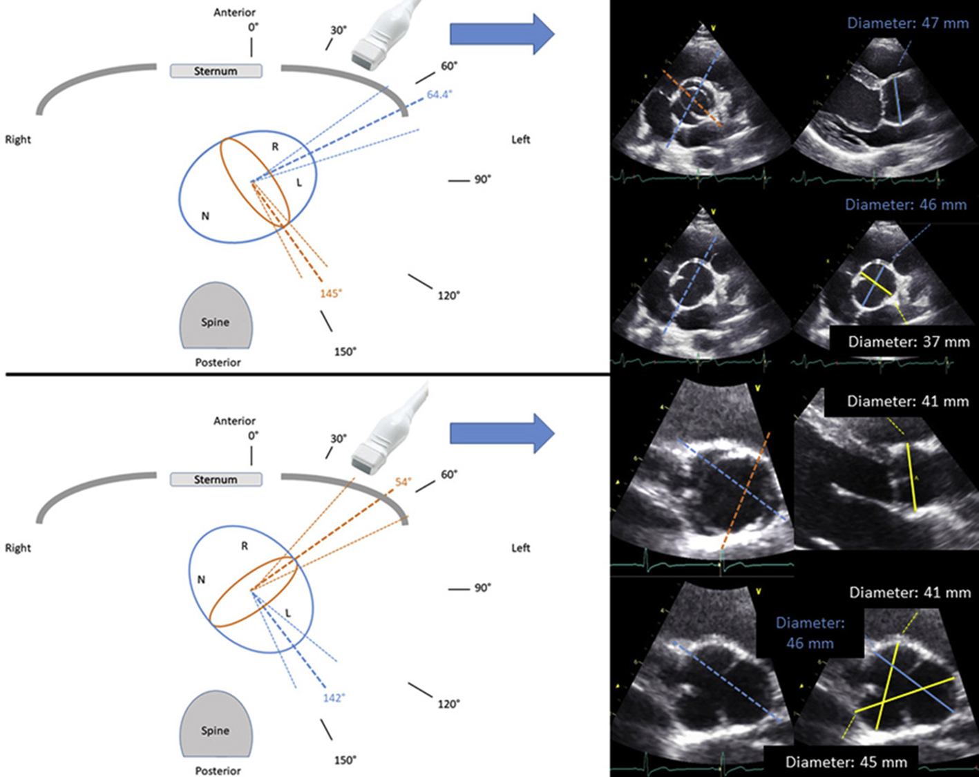
R-L fusion
Valve opening Horizontal
Maximal diameter is vertical
R-N fusion
Valve opening vertical
Maximal diameter is horizontal

Slide 21
PLAX on TTE
Underestimates maximal aortic root diameter in R-N BAV > R-L BAV
Hence short axis view by TTE may be useful as a initial evaluation in root asymmetry.

Slide 22
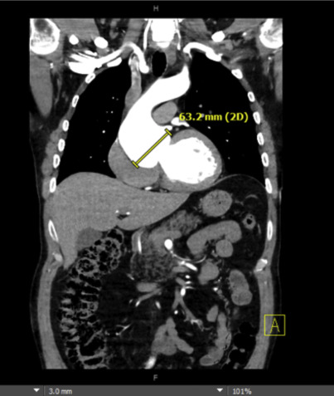
CMR and CT → Gold standard for aorta size evaluation
Overestimates aortic diameter
Compared to current double oblique method
Some researchers suggest → Reduction in aortic diameter threshold to indicate surgery at smaller dimensions.
Notes:
Guidelines on aortic intervention are based on traditional manual measurement of mid ascending aortic diameter on axial image and aortic root dimension on coronal image.
Current imaging modality gives a lesser value than older imaging modality that were over estimating
Double oblique – multiplanar reformation technique

Slide 23
Natural variability of aorta size related to patient age,sex, body size
Nomograms have been developed
Useful in Paediatric patients
Limited use in adults
Aortic dilation : Z score of > 2

Slide 24
Protocol for follow up imaging in BAV patients → Should be individualized
Frequency between 1-2 years →
Aortic diameters and
Cardiovascular risk factors
When there is agreement with ECHO and CMR/CT,
ECHO can be used as follow up
(but need to be confirmed by CT or CMR every 3 years)

Slide 25
CT/CMR
Aortic dilation not confined to aortic root /Proximal Asc. Aorta
Disagreement with Echo
Any diameter > 45mm by Echo , regardless of its location
Assess aortic root diameter when short axis by echo suggest asymmetric root

Slide 26
Assessment of Aortic stiffness
Distensibility and Circumferential strain →
Quantify the circumferential deformation experienced the aorta wall during the cardiac cycle.
Longitudinal strain →
Contraction of Left ventricle which moves the aortic valve plane downward and cyclically elongates ascending aorta
Pulse wave velocity → Structural stiffness
Notes:
Pulse wave velocity is the gold standard for aortic stiffness, measured by 4d flow cmr, 2d phase contrast cmr.
Aortic root stiffer in BAV patients especially in root dilatation even after correction , thus supporting the evidence of genetic triggering in this phenotype.

Slide 27
Assessment of Aortic flow pattern
4 - D flow CMR
Aortic wall sheer stress - Biomarker that can identify the potential need for surgery at follow up
Notes:
Assessment of established parameters like flow, velocity and regurgitation fraction.
. Wall shear stress (WSS) is the tangential force exerted by a flowing fluid on the vessel wal

Slide 28
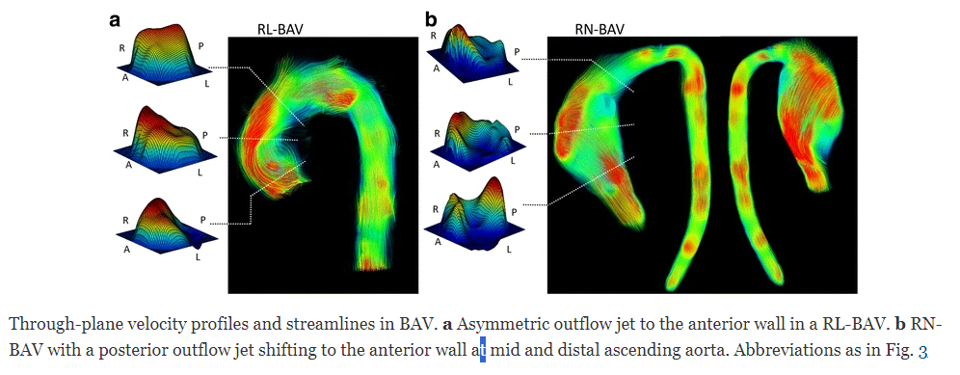
Notes:
In RL it is distributed Right anterior in proximal ascending aorta.
RN BAV, there will be posterior distribution of flow in proximal part shifting anteriorly in mid and distal asc aorta,.
Circumferential WSS is increased in mid and distal asc aorta and aortic arch

Slide 29
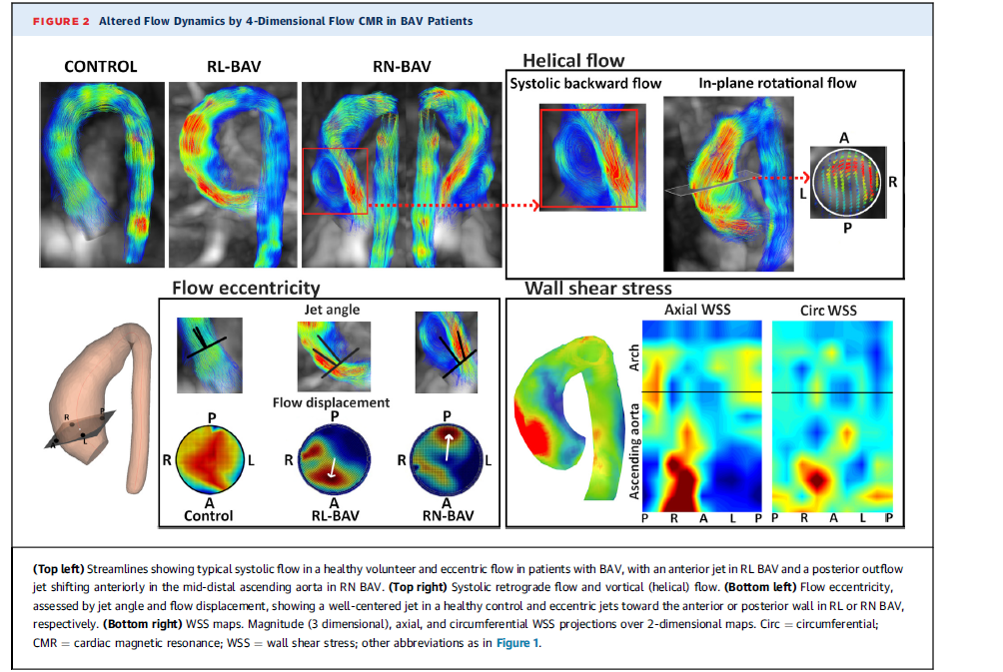

Slide 30
Notes:
Predominantly eccentric jet ;
Sustained, mainly righthanded helical flow;
Large retrograde flow in systole;
Increased turbulent kinetic energy and viscous energy loss.
These abnormal flow characteristics may result in the WSS
increase seen in BAV patients, which is associated with aorta wall elastic fiber thinning and degeneration and extracellular matrix dysregulation

Slide 31
Flow displacement & Flow reversal ratio- higher value suggest non laminar flow
Notes:
1st image- red jet is central 2nd image- red jet is in periphery suggesting more flow displacement
1st image- mainly red flow, 2nd image- blue flow suggesting systolic flow reversal and more flow reversal.

Slide 32
Mechanism of Aortic dilation

Slide 33
Notes:
Altered flow hemodynamics occurs even in absence of valve dysfunction

Slide 34
Notes:
Bicuspid aortic valve aortopathy can progress after valve replacement! This pt 36 years post ball-in-cage AVR (still working) now with >5cm aneurysm.
So this altered haemodynamics alone must not be contributing to the aneurysm.

Slide 35
Mechanism of aortic dilation
Genetic factor → Intrinsic alteration of the aortic wall component
(More aggressive surgical approach than in TAV)
Hemodynamic hypothesis → Altered flow hemodynamics
( Indication of surgery similar to TAV, possibly based on flow biomarkers)
Notes:
These hypothesis is not mutually exclusive and current evidence indicates a role of both mechanism in the setting of BAV.

Slide 36
Genetic factors
Most cases → Sporadic
Underlying Genetic abnormality
Autosomal dominant pattern , Incomplete penetrance
1st degree relatives → 6% ( men > women)
Genetic syndrome → Turner syndrome
Notes:
2) Familial clustering and monozygotic twins
4) Loss of genes on X chromosomes male predominance
5) Partial or complete absence of x chromosome

Slide 37
30% of Turner patients have BAV
Higher prevelance of ( compared to Sporadic BAV)
Coarctation
Aortic aneurysm
Acute aortic dissections

Slide 38
Notes:
A study showed 30% of patients initially considered as having TAV with asc aortic aneurysm
Had Presence of small valve leaflet fusion( <50%)

Slide 39
Genetics and molecular basis of BAV
NOTCH 1 → Inherited aortic valve disease and with other left and right sided disease ( Tof, HLHS,TA)
ACTA2 → BAV and different vascular disease
TGFRB1 and TGFRB2 – Loeys Deitz syndrome → higher prevelance of BAV
?Marfan
Epigenetic alteration → can contribute to Aortic dilation
Notes:
heritable chemical or physical changes in chromatin

Slide 40
Genetic testing is not recommended for the typical BAV presentation, even if familial.
( unless there is a family history of aortic dissection or early or unexplained sudden cardiac death or syndromic features)

Slide 41
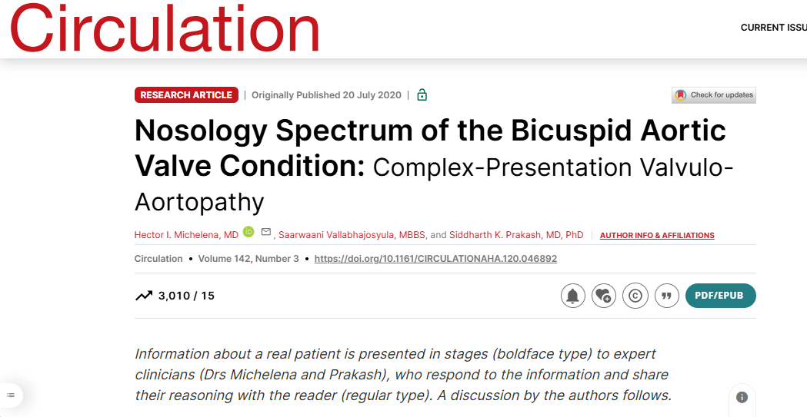

Slide 42
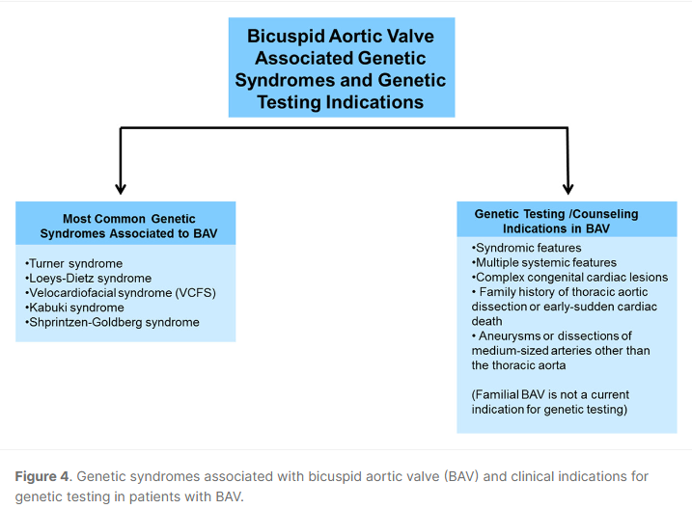

Slide 43
The frequency of aortic dissection varies by causal gene LDS
Carriers of TGFBR1 and TGFBR2 pathogenic variants → Earlier and more highly penetrant aortic events (median age at first event, 28 to 34 years)
than
Carriers of the SMAD3 pathogenic variant (median age at first event, 45 years).

Slide 44
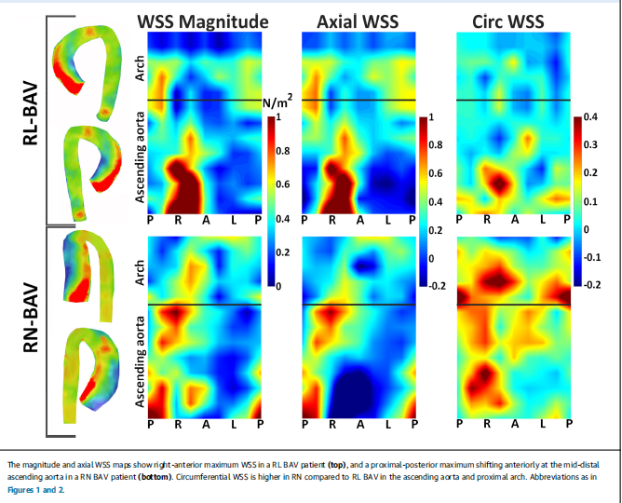
Notes:
RL= proximal anterior and right in aortic root
RN- proximal posterior jet shiting anteriorly in mid distal asc ao
RN have more severe flow abnormalities, more eccentric flow and rotational flow.

Slide 45
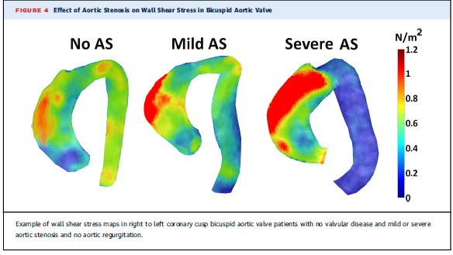
Impact of Valvular dysfunction
Aortic valve stenosis further exacerbates Ascending Aorta flow alteration
Notes:
Altered haemodynamics can occur in absence of valve dysfunction.
But if there is an associated valve dysfunction it may exacerbate.

Slide 46
Severe AR →
Homogenous increase in regional Wall stress due to increased stroke volume

Slide 47
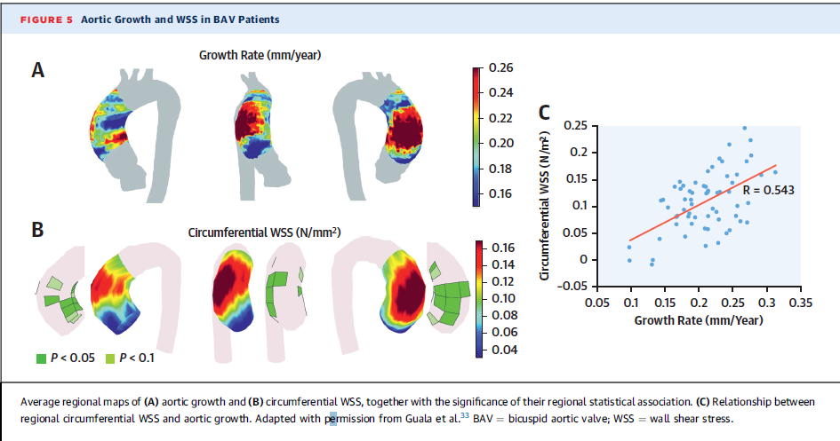
Notes:
part of ascending aorta wall that was exposed to abnormally high wss was associated with increased ascending aorta growth rate.

Slide 48
Take home message
An initial 4D flow CMR at diagnosis may help to identify BAV patients with increased risk of dilation , which may deserve a close follow up.

Slide 49
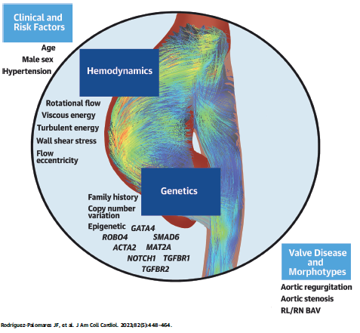
Notes:
Aortic root- Mainly genetic alteration
Ascending aorta- Altered Haemodynamics

Slide 50
THANK YOU

